Slide 1

AtliQ Hospitality Analysis
Dashboard Insights and Strategic Recommendations

Slide 2

Table of Contents:
Company Overview
Dataset Details
Model Creation
Dashboard insights
Strategic Recommendation
Conclusion

Slide 3

AtliQ
AtliQ Grands owns multiple five-star hotels across India. They have been in the hospitality industry for the past 20 years. Due to strategic moves from other competitors and ineffective decision-making in management, AtliQ Grands are losing its market share and revenue in the luxury/business hotels category. As a strategic move, the managing director of AtliQ Grands wanted to incorporate “Business and Data Intelligence” in order to regain their market share and revenue. However, they do not have an in-house data analytics team to provide them with these insights.
Their revenue management team had decided to hire a 3rd party service provider to provide them insights from their historical data.

Slide 4

Process includes:
Importing and verifying data. few transformations and cleaning in power query 2) Data modeling 3) Identifying & Creating Measures using DAX. 4) Validating all data 5) Creating Dashboard using appropriate Visualization.
Visualization Tool : Power Bi Database : Excel

Slide 5
Dataset details
3 month booking Details of All the AtliQ hotels
Dataset contain 5 Excel files:
Dim_dates
Dim_hotels
Dim_Rooms
Fact_aggregated_bookings
Fact_bookings

Slide 6

Key Performance Indicators(KPIs):
Total Revenue
Revenue by segment
Occupancy Rate
RevPAR(Revenue per Available Room): RevPAR represents the revenue generated per available room, whether or not they are occupied. RevPAR helps hotels measure their revenue generating performance to accurately price rooms. RevPAR can help hotels measure themselves against other properties or brands.
ADR(Average Daily Rate): It is the ratio of revenue to the total rooms booked/sold. It is the measure of the average paid for rooms sold in a given time period
Customer Satisfaction:
Realization Percentage by platform: It is nothing but the successful "checked out" percentage over all bookings happened.

Slide 7
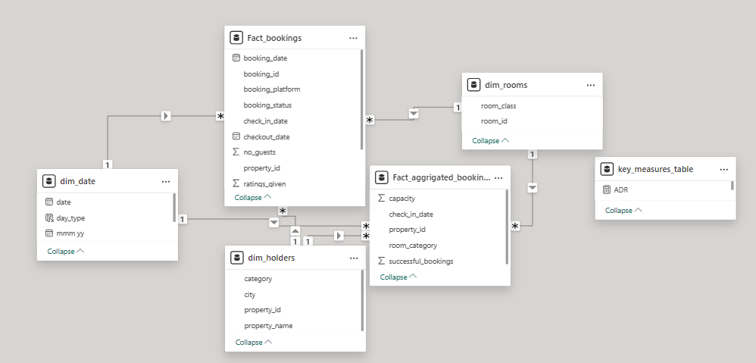
Data Model:

Slide 8
Dashboard Insights:
Revenue peaks during weekends with a notable higher RevPAR and occupancy rate
Mumbai leads in revenue generation, while Delhi has the highest occupancy rate
Utility costs are rising, indicating a need for energy-saving measures.
Direct booking have the highest realization percentage, emphasizing the importance of promoting direct channels
Total Revenue:1.69 billion
Overall occupancy rate: 57.79%
Overall RevPAR: 7,336.56
Overall ADR: 12,695.76

Slide 9
Tooltip overview:
Revenue Insights Tooltip:
Weekday revenue tends to be lower compared to weekends, suggesting that guests prefer weekend stays, possibly due to leisure travel preferences.
Occupancy Insights Tooltip:
Higher occupancy on weekends indicates a trend where guests are more likely to book stays for leisure trips over weekends.
RevPAR Insights Tooltip:
The significant difference in RevPAR between weekdays and weekends shows that higher rates and better occupancy on weekends drive profitability.
ADR Insights Tooltip:
Consistent ADR across weekdays and weekends suggests stable pricing strategies, but slight weekend increases indicate a premium charged for high demand periods.
Customer Satisfaction Tooltip:
Delhi's higher rating suggests strong service and guest satisfaction, while Mumbai and Bangalore could benefit from focused service improvements.
Platform Performance Tooltip:
Higher realization from direct bookings suggests that reducing reliance on third-party platforms can enhance profitability through lower commission costs.

Slide 10
Recommendations:
Enhance Marketing Efforts: Target peak seasons and weekends with special promotions to maximize revenue.
Cost Management: Implement energy-saving initiatives to combat rising utility costs
Focus on Direct Bookings: promote direct booking platforms to maximize realization percentages and ADR.
Service improvement: Investigate and improve service issues in cities with lower customer satisfaction ratings, especially during specific months.

Slide 11
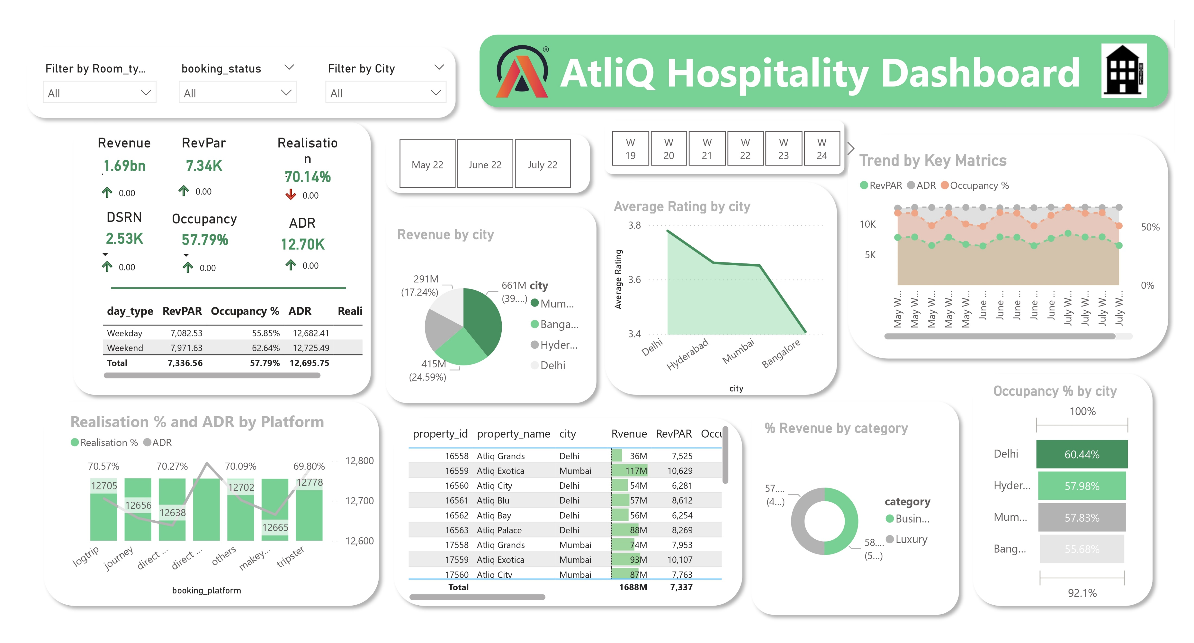

Slide 12
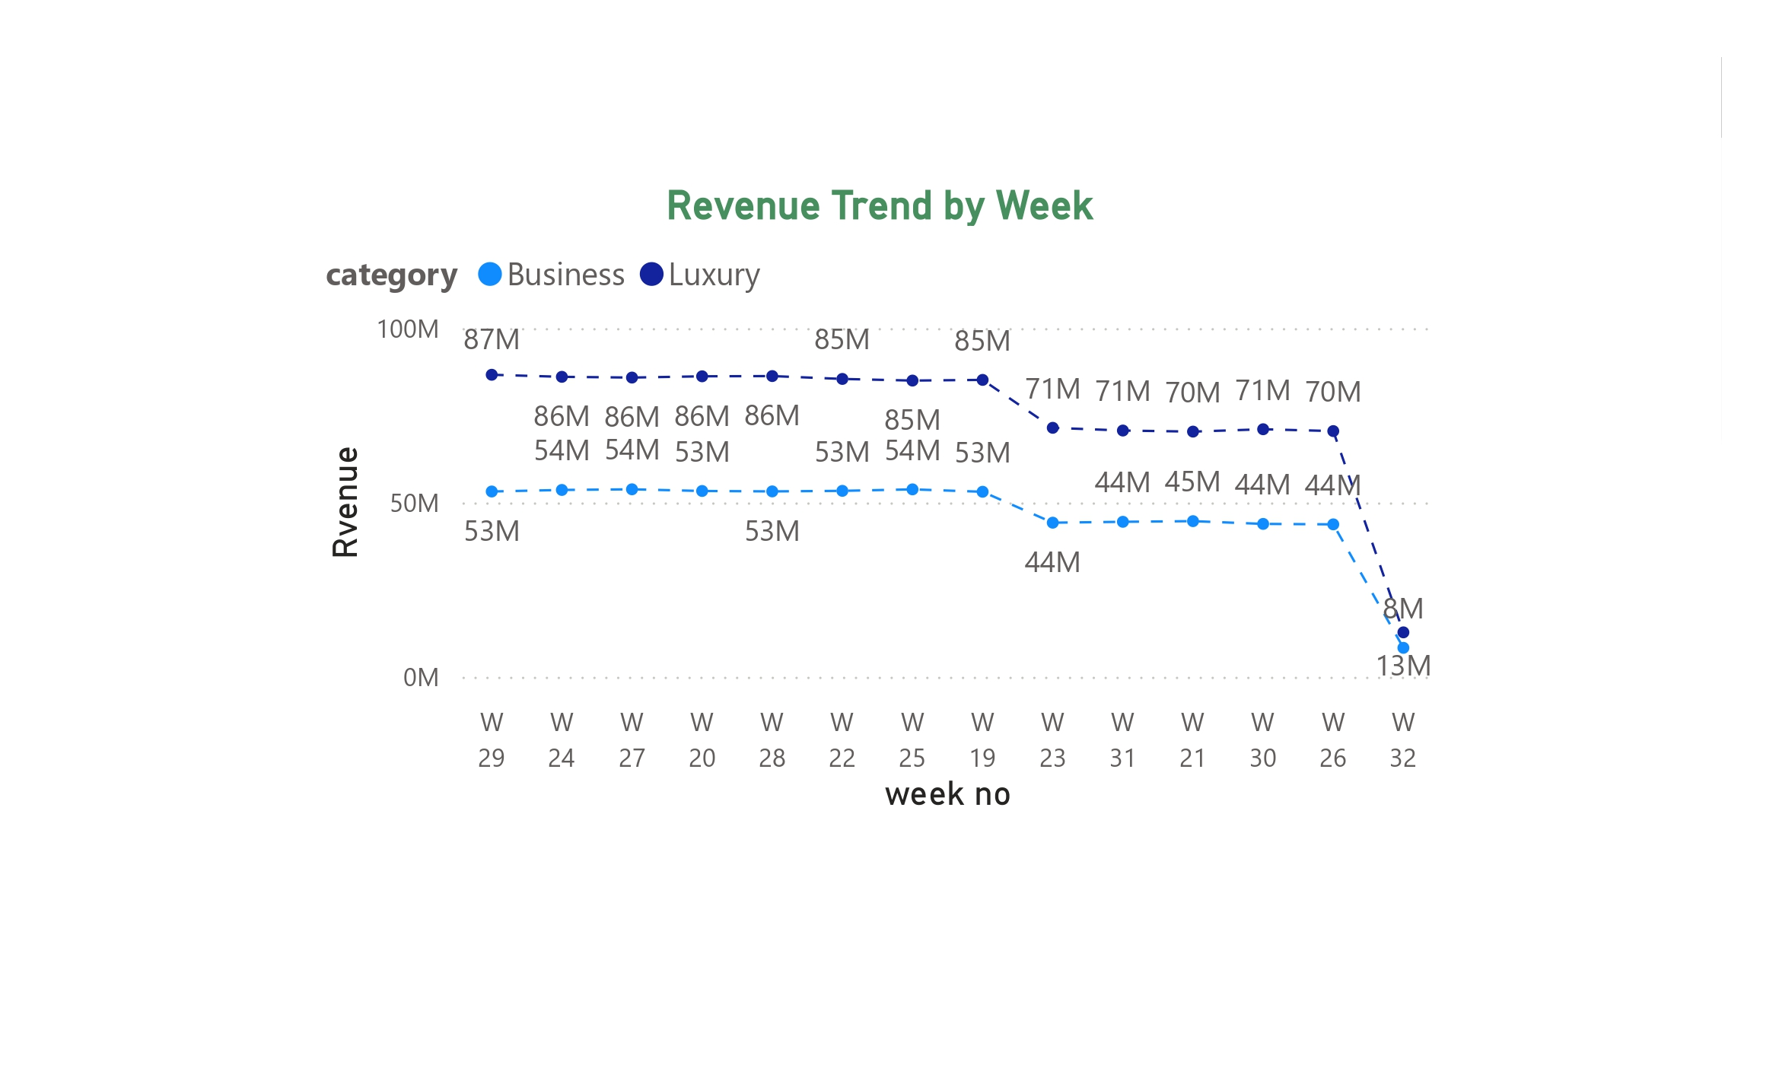
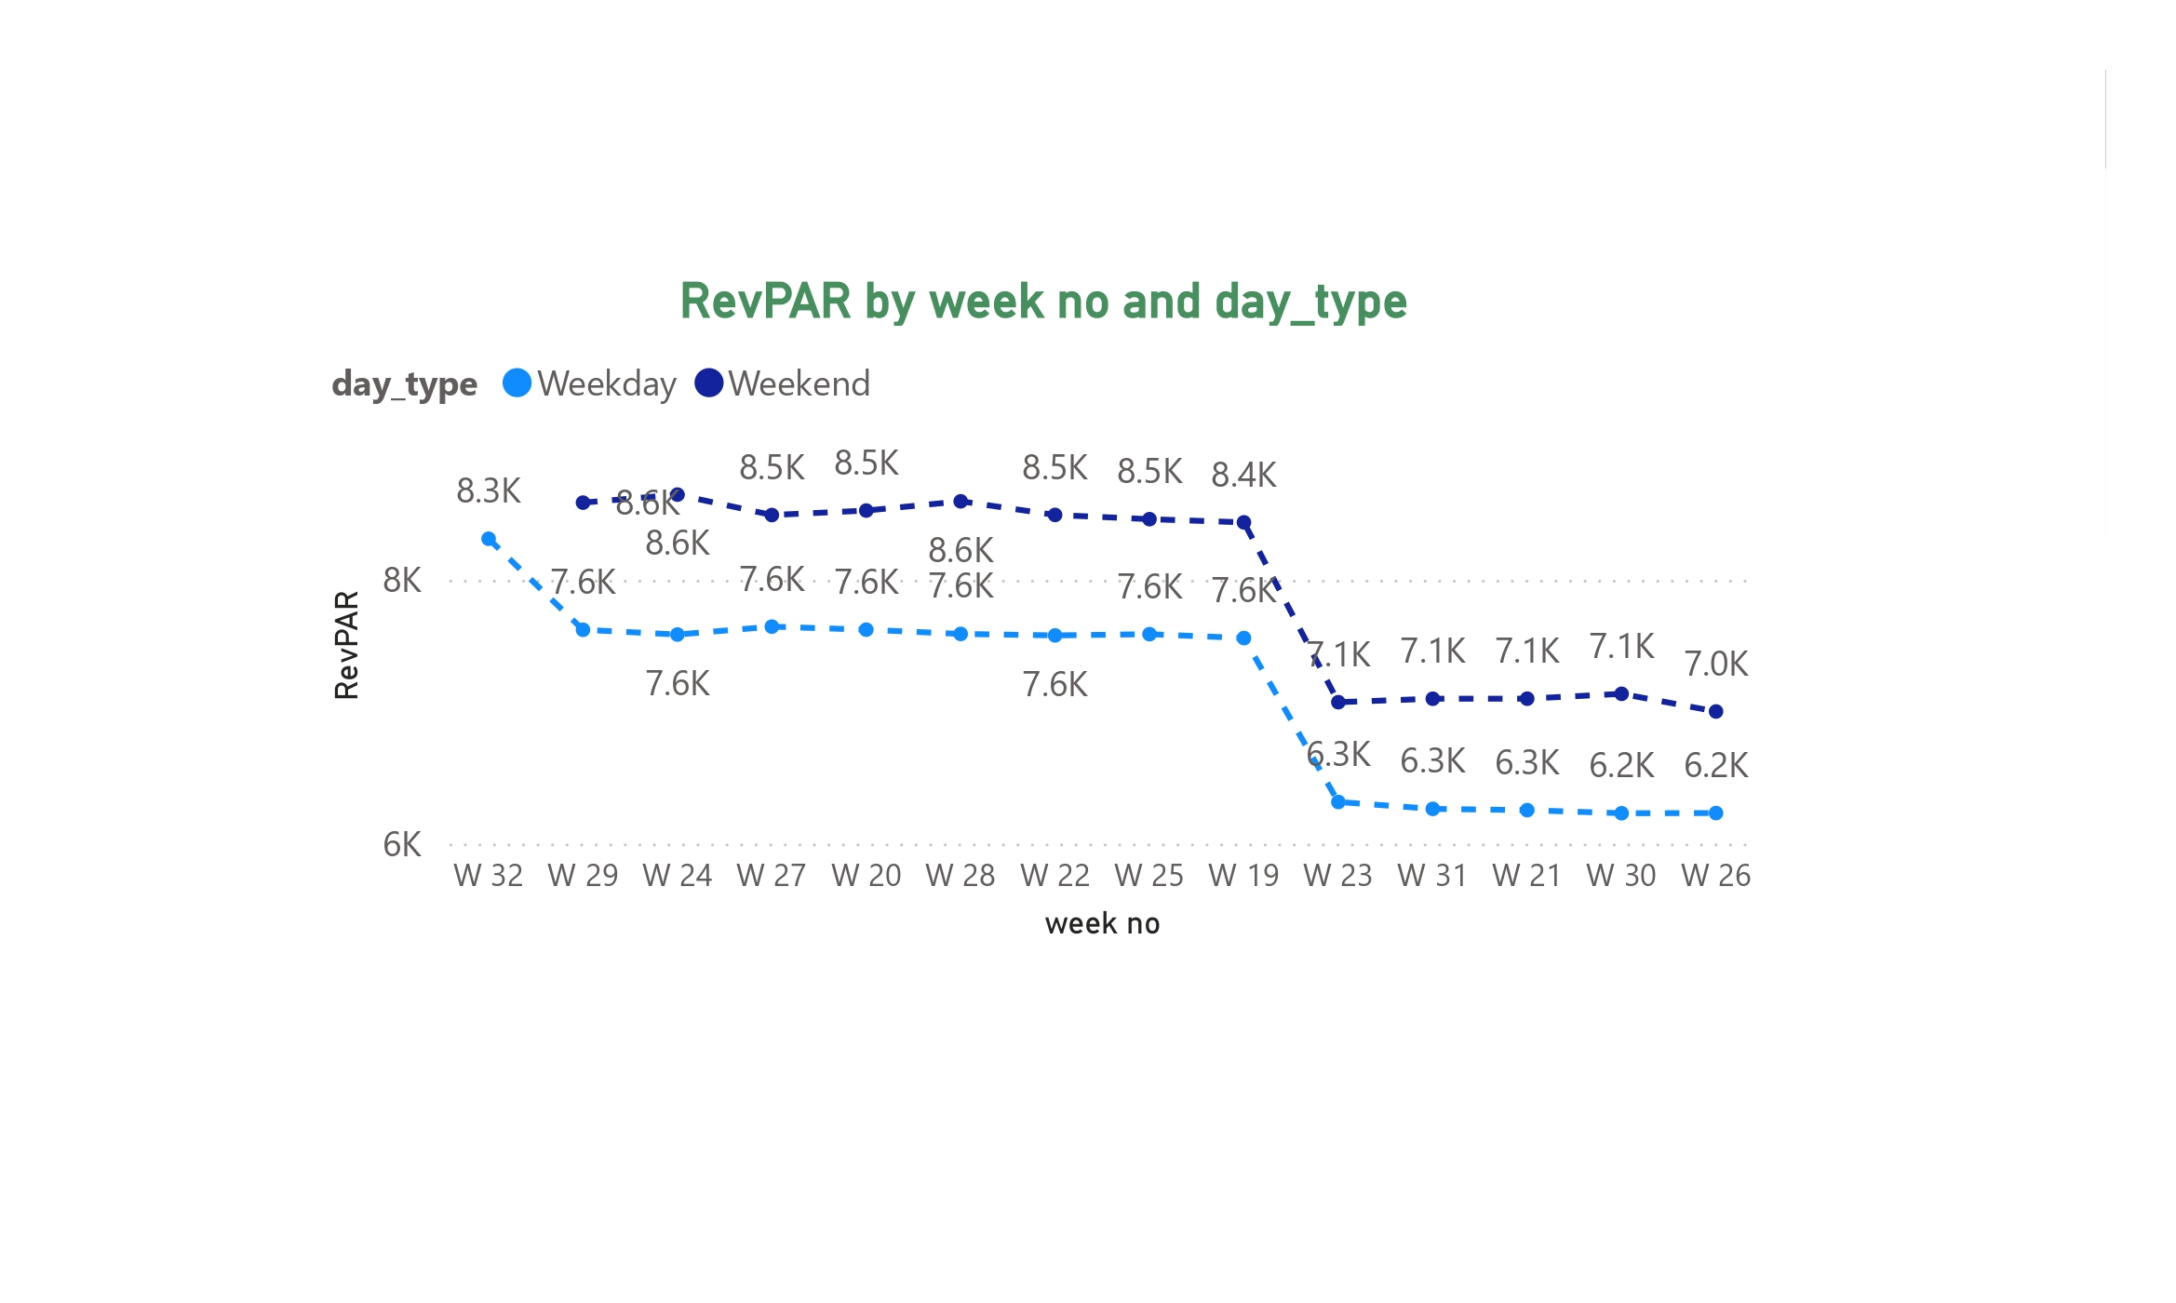
Tooltip graphs:

Slide 13
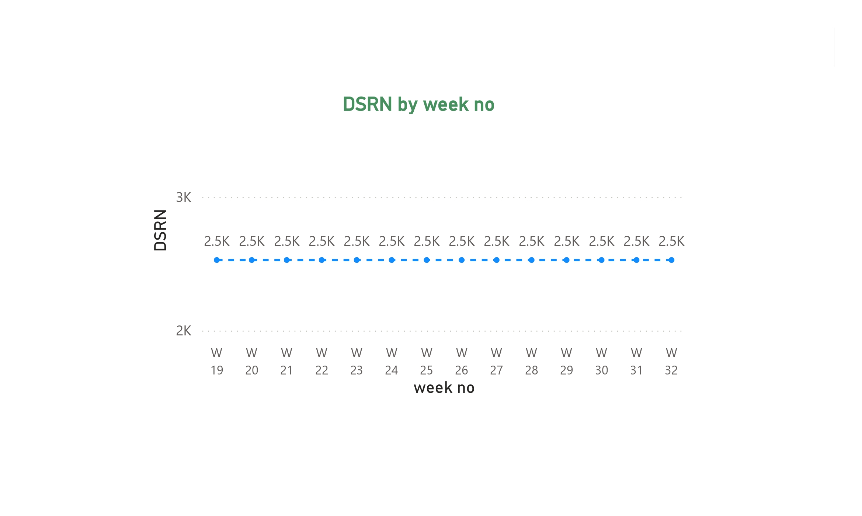
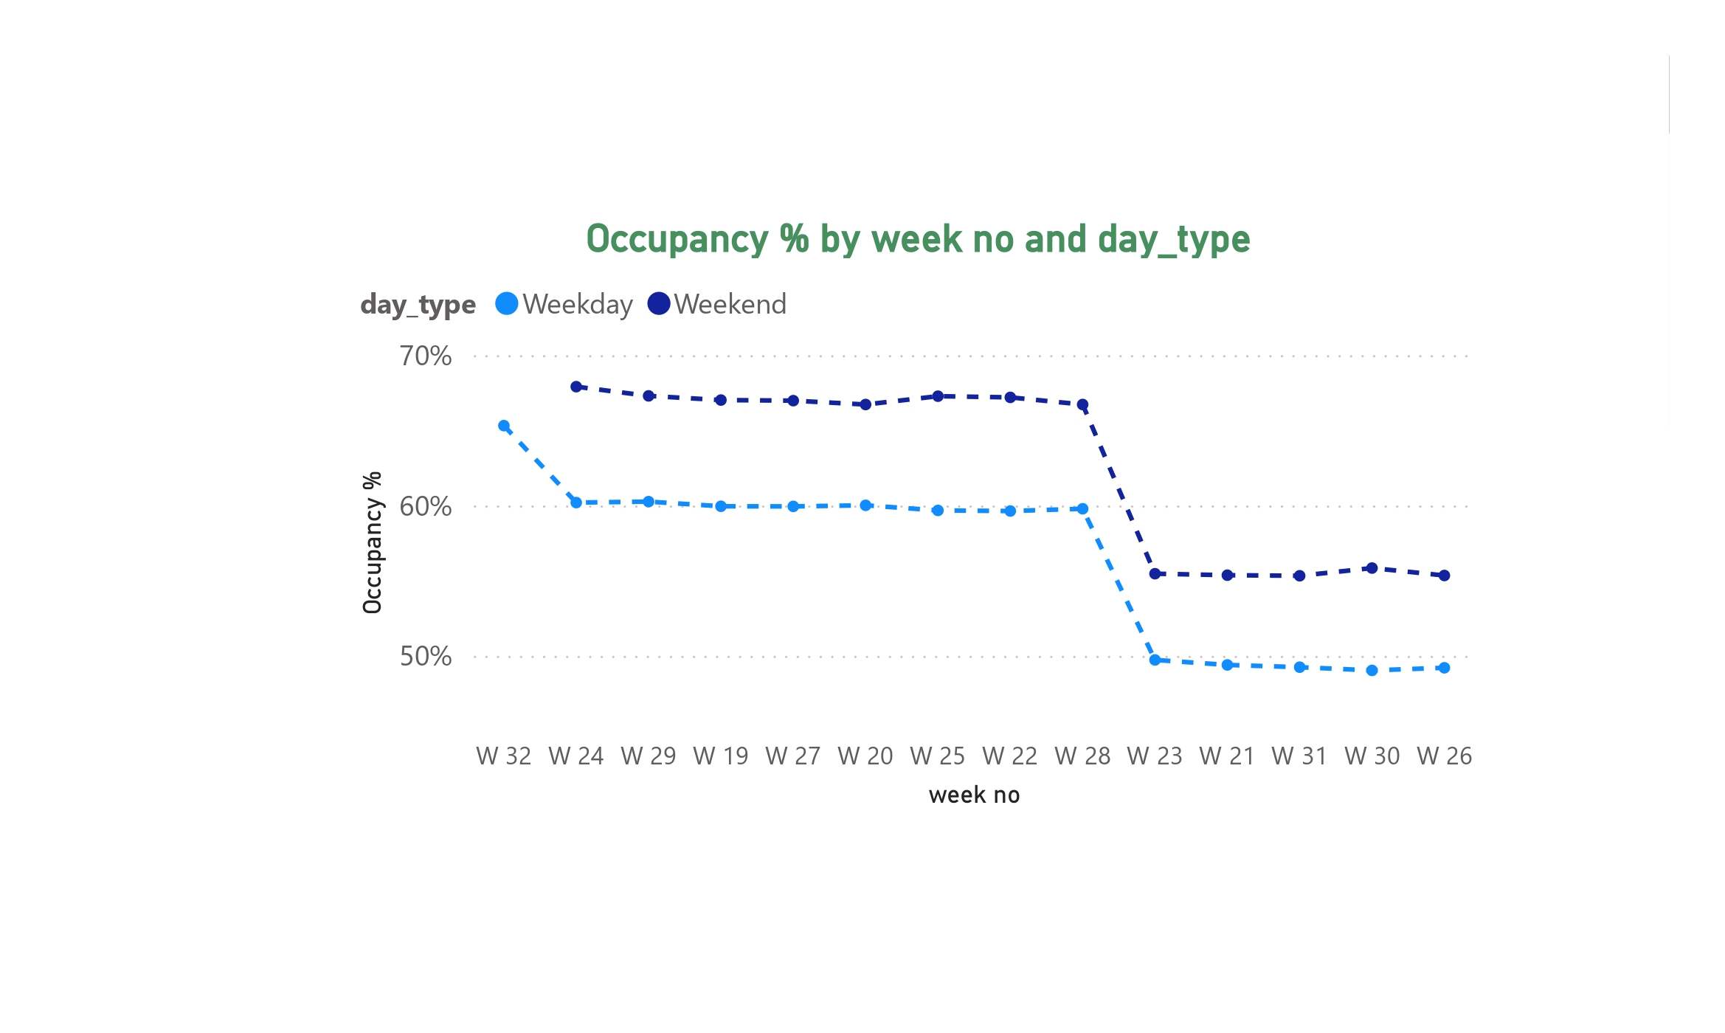
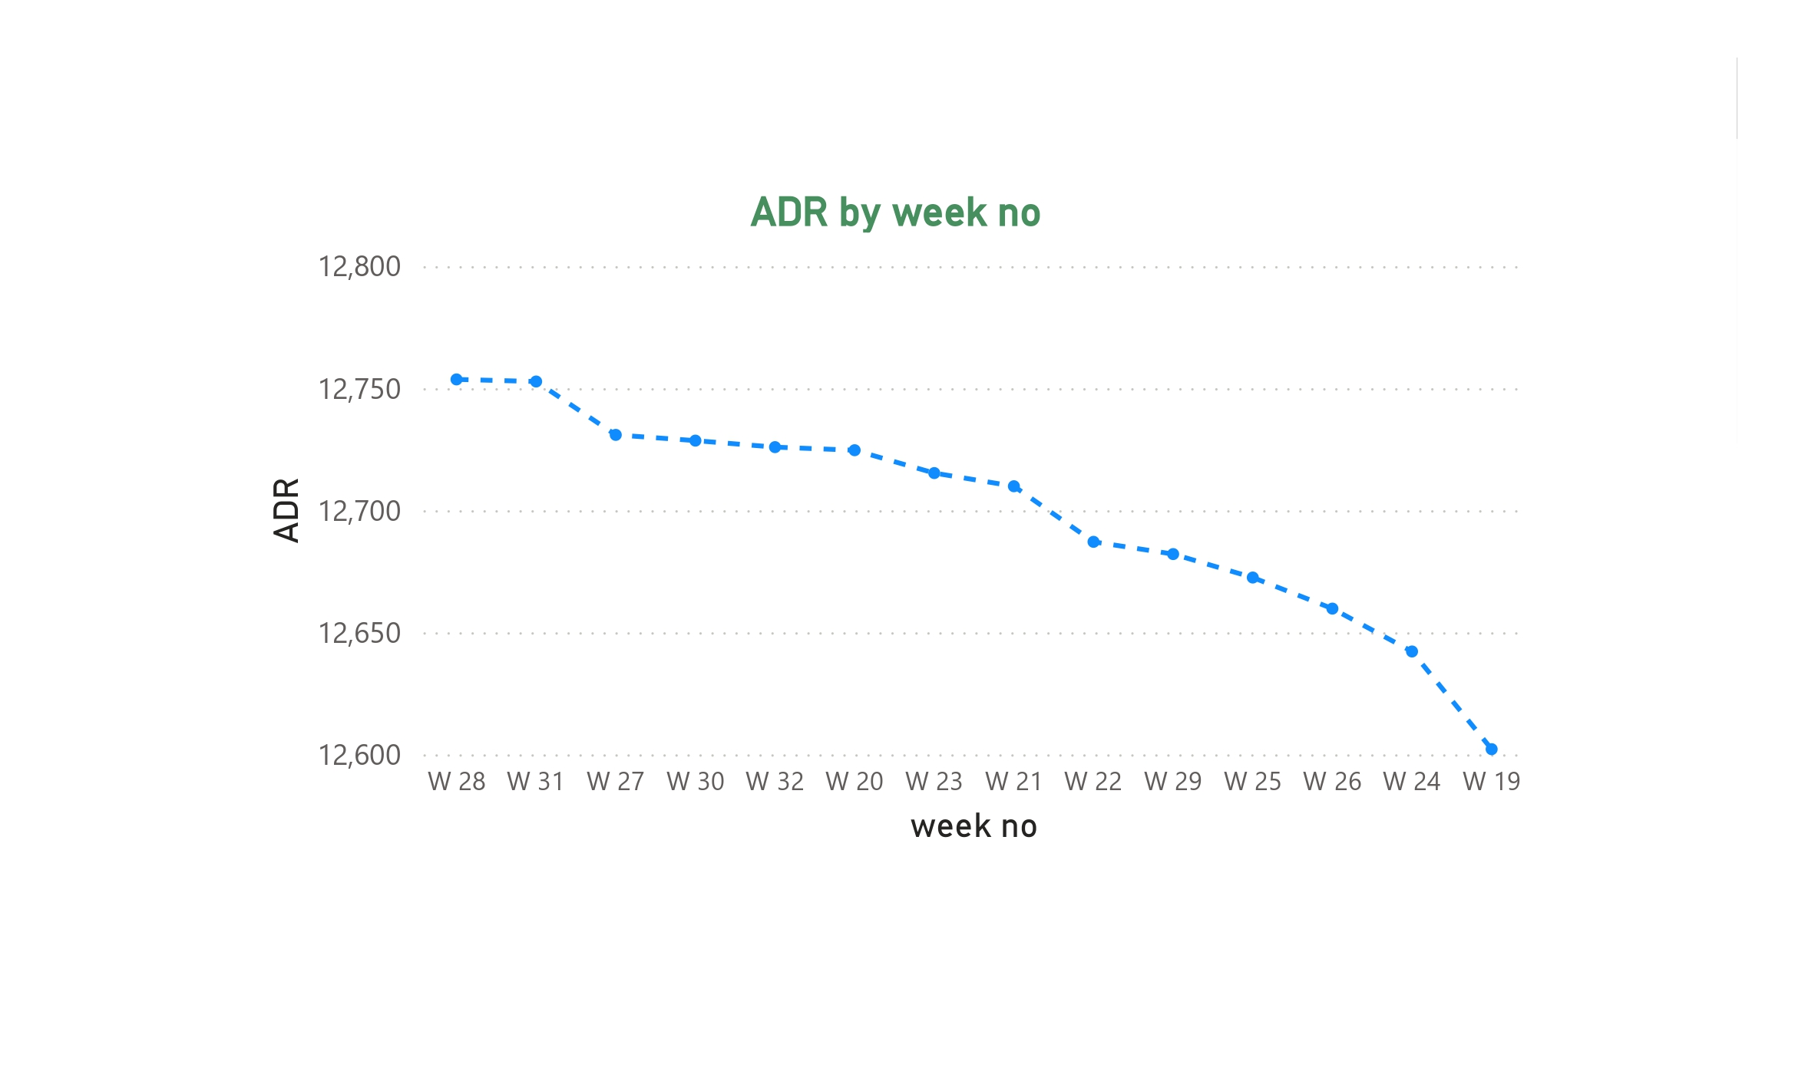
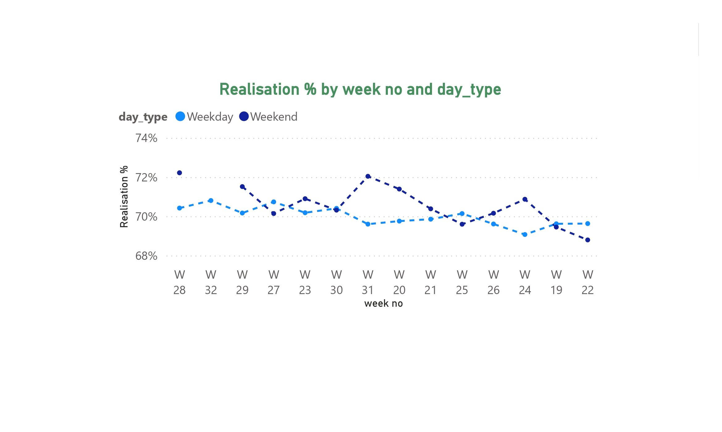

Slide 14
Conclusion
AtliQ Hospitality's dashboard analysis reveals several key insights: revenue peaks on weekends, Mumbai generates the highest revenue, and Delhi maintains the highest occupancy rate. Direct bookings show the highest realization percentage, highlighting the potential for increased profitability through direct channels. However, rising utility costs and varied customer satisfaction ratings indicate areas for improvement. By enhancing marketing efforts during peak seasons, focusing on direct bookings, implementing cost-saving measures, and addressing service issues in lower-rated cities, AtliQ can optimize its performance and drive future growth.

